Slide 1
Azure Governance
Compliance and Security

Slide 2



Eric Leonard
Solutions Architect
Cistel Technology Inc.
Twitter: @erleonard
LinkedIn: https://www.linkedin.com/in/erleonard/
Website: http://erleonard.me
GitHub: https://github.com/erleonard

Slide 3
Agenda
Policies
Compliance
Security

Slide 4
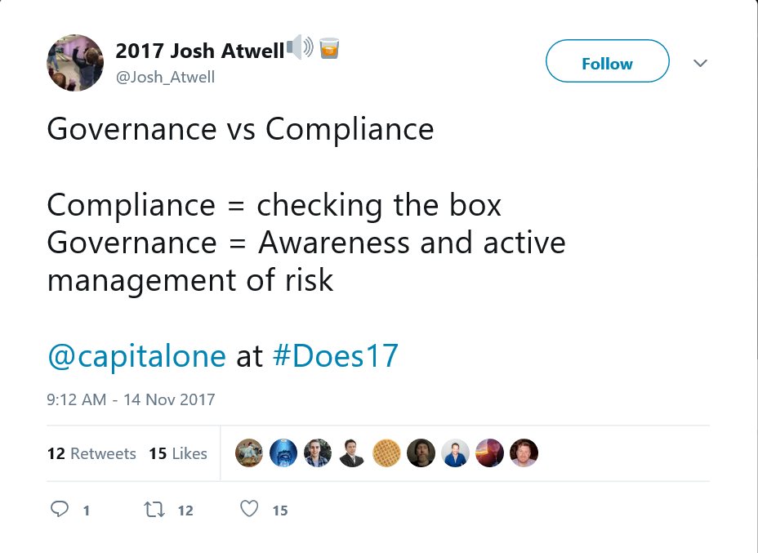
DevOps Enterprise Summit 2017

Slide 5


Challenges
How do I meet our legal requirements for data sovereignty?
How do I enable charge back across departments / Teams
How do I ensure that someone does not inadvertently change a critical system?

Slide 6
Naming Convention
Verbose Azure subscriptions names make understanding the context and purpose of each subscription clear.
Easy to locate
Concise
<Company> <Department (optional)> <Product Line (optional)> <Environment>
Notes:
Resource and examples for naming Azure naming convention: https://docs.microsoft.com/en-ca/azure/architecture/best-practices/naming-conventions

Slide 7
Naming Convention (Cont.)
Company | Department | Product Line or Service | Environment | Full Name
TLAB | satAZUREday | AwesomeService | Production | TLAB satAZUREday AwesomeService Production
TLAB | SocialGaming | AwesomeService | Dev | TLAB satAZUREday AwesomeService Dev

Slide 8
Naming Convention (Cont.)
Verbose Azure resources names make it easy to understand the purpose and workload.
Resource Groups: RG-Region-Type-Subtype/Workload | RG-CC-VM-Identity RG-CE-Network
Networking: Vnet-Region-Type-SubType/Workload | Vnet-CC-GW ILB-CE-SQL
Storage Accounts: sa[company][department][region][Type][workload] * All lower case | sacticamsccvmsql.core.windows.net
Virtual Machines: [Region][Role][Number] | ccdc01

Slide 9
Policies
Azure Policy is a service in Azure that you use to create, assign and, manage policy definitions.
Policy definitions enforce different rules and actions over your resources, so those resources stay compliant with your corporate standards and service level agreements.

Slide 10
DEMO

Slide 11
Resource Tags
Resource Tags are extremely important to associate resources with the appropriate department, customer, and environment.
Resource tags are flexible and easy to implement.
Can be included in your ARM templates
Examples of common resource tags are:+
BillTo
Department (or Business Unit)
Environment (Production, Stage, Development)
Tier (Web Tier, Application Tier)
Application Owner
ProjectName

Slide 12
DEMO

Slide 13
Azure resource locks
Resource locks enable you to restrict operations on high-value resources where modifying or deleting them would have a significant impact on your applications or cloud infrastructure.
Apply locks to a subscription, resource group, or resource.

Slide 14
DEMO

Slide 15
Cost management and optimization
Monitor usage and spending
Manage costs
Improve efficiency

Slide 16
Final Word
User automation whenever possible
Azure Security Center
Enabled by default in each subscription.
Must enable data collection from virtual machines to allow Azure Security Center to install its agent and begin gathering data.

Slide 17

Questions

Slide 18
Notes:
© Copyright PresentationGo.com – The free PowerPoint library

